Slide 1
Increasing and Decreasing Functions

Slide 2
Objectives
Upon completion of this lesson, you should be able to:
find where functions are increasing or decreasing

Slide 3
A function f is increasing on (a, b) if f (x₁) < f (x₂) whenever x₁ < x₂.
A function f is decreasing on (a, b) if f (x₁) > f (x₂) whenever x₁ < x₂.
Increasing
Decreasing
Increasing
Increasing/Decreasing Functions

Slide 4
Increasing/Decreasing/Constant Functions

Slide 5
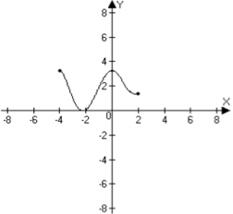
Example
In the given graph of the function f(x), determine the interval(s) where the function is increasing, decreasing, or constant.
The function is decreasing on the interval (-4, -2)
The function is increasing on the interval (-2, 0)
The function is decreasing on the interval (0, 2)

Slide 6
Example
Determine the intervals where
is increasing and where it is decreasing.
At x = -2 (ie. less than 0)
At x = 5 (ie. greater than 4)
At x = 1 (ie. btwn 0 and 4)
Ie. positive
Ie. positive
Ie. negative
+ - +
0 4
f is decreasing
on
f is increasing
on

